Slide 1

Handwritten Character Recognition using Deep Learning
by
V.Sai Sooraj
Roll No. 184G1A05B8
P.Rupeshwara
Roll No. 184G1A0569
K.Shreya
Roll No. 184G1A0588
G.Rupa
Roll No. 184G1A0567
Under the guidance of
Mrs.S.Sunitha.M.Tech.(Ph.D).
Assistant Professor
Department of Computer Science and Engineering
Srinivasa Ramanujan Institute of Technology
(Affiliated to JNTUA & Approved by AICTE) (Accredited by NAAC with ‘A’ Grade & Accredited by NBA (EEE, ECE & CSE)
Rotarypuram Village, B K Samudram Mandal, Ananthapuramu – 515701.
2021 - 2022

Slide 2
Abstract
The aim of this project is to classify handwritten characters using classification algorithms. The goal is to take an image of a handwritten character and determine character . The characters includes English alphabets. It is a solution to extract the data text. Handwritten Character Recognition is a field of research in Artificial Intelligence, Computer vision and Pattern Recognition.
We have designed a image segmentation based Handwritten character recognition system. In our system we have made use of OpenCV for performing Image processing and have used TensorFlow for training a neural Network. We have developed this system using python programming language.

Slide 3
Contd…
In this project we present an innovative method for offline handwritten character detection using deep neural networks. In today world it has become easier to train deep neural networks because of availability of huge amount of data and various Algorithmic innovations which are taking place. Now-a-days the amount of computational power needed to train a neural network has increased due to the availability of GPU’s and other cloud-based services like Google Cloud platform and Amazon Web Services which provide resources to train a Neural network on the cloud.

Slide 4

Contents
Introduction
Literature Survey
Existing System
Proposed System
Problem Definition
Requirements
Uml Diagrams
Data Flow Diagram
Sample Code
Screenshots
Conclusion
References

Slide 5
Introduction
The purpose of this project is to take handwritten English characters as input, process the character, train the neural network algorithm, to recognize the pattern or structure of characters, and matches the character or the output with the desired input.
Pattern recognition is perhaps the most common use of neural networks. The neural network is presented with a input which contains the pattern information, this could be an image, and hand written data.
The neural network then attempts to determine if the input data matches a pattern that the neural network has mentioned.

Slide 6
Contd…
A neural network trained for classification is designed to take input samples and classify them into groups.
These input groups may be fuzzy, without clearly defined boundaries. This project concerns detecting free handwritten characters.

Slide 7
Literature Survey
Aiquan Yuan, Gang Bai, Lijing Jiao, Yajie Liu “Offline Handwritten English Character Recognition based on Convolutional Neural Network” das.2012.61 english.pdf
Handwritten English Character Recognition (HECR) has been a fairly challenging research topic in Optical Character Recognition (OCR). Up to now, there have been lots of fruitful researches for HECR . However, most of them are carried out with online information, or with online and offline hybrid classifier; researches with pure offline information are rare . As handwritten characters are unconstrained and topologically diverse, HECR with pure offline information has much difficulty.

Slide 8
Contd..
N Prameela , P Anjusha, R Karthik “Off-line Telugu Handwritten Characters Recognition using optical character recognition” B-06\ICECA.2017.8212801 TELUGU.pdf
This paper proposes an OCR system for Telugu documents which comprises of three stages, namely pre-processing, feature extraction, and classification. In the preprocessing stage, we have employed median filtering on the input characters and applied normalization and skeletonization method over characters for extraction of boundary edge pixel points. In the feature extraction stage, initially the each character is divided into 3×3 grids and the corresponding centroid for all the nine zones are evaluated. With this we can identify the characters of different styles.

Slide 9
Contd…
Prof. Vaibhav. V.Mainkar, Mr.Ajinkya B. Upade, Ms.Jyothi A.katkar and Ms.Poonam R.Pednekar, “Handwritten Character Recognition to obtain Editable Text” .
Available in: file: ICESC48915.2020.9155786 EDITABLE TEXT.pdf
The method to transform handwritten data into electronic format is ‘Optical Character Recognition’. It involves several steps including pre-processing, segmentation, feature extraction and post-processing. Many researchers have been used OCR for recognizing character. This system uses the android phone to capture the image of the document and further steps are done by OCR. The main challenge is to recognize the characters from different styles of handwriting. Thus, a system is designed that recognizes the handwritten data to obtain an editable text. The output of this system depends upon the data that has to be written by the writer. Our system offers 90% accuracy for handwritten documents and gives the easiest way to edit or share the recognized data.

Slide 10
Existing System
In this running world there is a demand for the users to convert the printed documents into electronic documents for maintaining the security of the data.
Paper-1:
In the existing OCR(Optical Character Recognition) system have the capability to detect telugu alphabets only.
Support Vector Machine and Radial Basis Function algorithms are used.
Paper-2:
This paper shows the solution for HECR(Handwritten English Character Recognition) with CNN (Convolutional Neural Networks) concept.

Slide 11
Contd…
There are many are many fields in Handwriting Recognition is one of the active areas of research where deep neural networks are being utilized. Recognizing handwriting is an easy task for humans but a daunting task for computers.
Handwriting recognition systems are of two types: Online and Offline. In online handwriting recognition system the handwriting of the user is recognized as the user is writing. The information like the order in which the user has made the strokes is also available. But in offline handwriting recognition system, the handwriting of user is available as an image. Handwriting recognition is a challenging task because of many reasons.

Slide 12
Contd…
The primary reason is that different people have different styles of writing. The secondary reason is there are lot of characters like Capital letters, Small letters, Digits and Special symbols. However even the most modern and commercially available systems have not been able to achieve such a high accuracy .

Slide 13
Disadvantages:
Failure for the data maintained.
Expensive.
Inefficient.
Requires planning and time
Time consuming.

Slide 14
Proposed System
Our proposed system is able to recognize the of English characters .
The present system is able to recognize the characters with good accuracy and speed .
To overcome the limitation of the existing system, we develop a hand writing character recognition system which uses deep learning models in conjunction with computer vision to achieve good accuracies in characters detection and recognition.
For this we use Convolutional Neural Networks (CNN) techniques to solve the problem and also to improve the accuracy .

Slide 15
Advantages
Inexpensive.
Efficient.

Slide 16
Problem Definition
In the digital world ,it is time consuming and cost inefficient to store the files physically . And also it is very challenging task to store the files safe and secure without any damages or loss of information. We cannot extract the information from those files quickly. Contradictions may raise when there is no efficiency in the information. To overcome this problem OCR technology is used .
There are many are many fields in Handwriting Recognition is one of the active areas of research where deep neural networks are being utilized. Recognizing handwriting is an easy task for humans but a daunting task for computers.

Slide 17
Contd…
In online handwriting recognition system, the handwriting of the user is recognized as the user is writing. The information like the order in which the user has made the strokes is also available. But in offline handwriting recognition system, the handwriting of user is available as an image. Handwriting recognition is a challenging task because of many reasons. The primary reason is that different people have different styles of writing. The secondary reason is there are lot of characters like Capital letters, Small letters, Digits and Special symbols. However even the most modern and commercially available systems have not been able to achieve such a high accuracy loss

Slide 18
Requirements:
SYSTEM SPECIFICATIONS :
H/W Specifications:
Processor : i3 or i5 Processor
RAM : 8 GB
Hard Disk : 128GB
S/W Specifications
Operating System : Windows 7+
Server-side Script : Python 3.6+
IDE : PyCharm
Libraries Used : Pandas, Numpy, OS, Keras
Framework : Flask
Database : MySQL

Slide 19
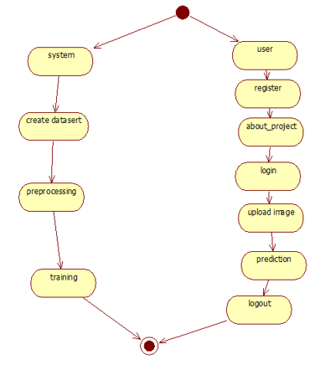
Activity Diagram:

Slide 20
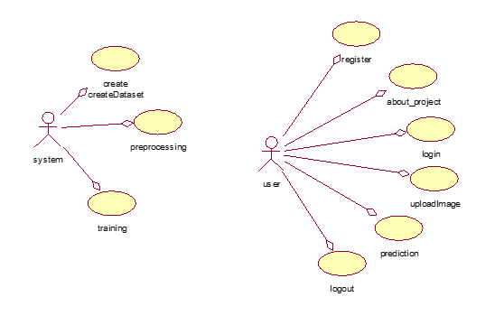
UseCase Diagram:

Slide 21
Data Flow Diagram
start
Input
Cleaning Data
Split the data
Testing
Training
Evaluation
Model
Stop

Slide 22
Implementation:
Resnet50 is the neural network algorithm used to classify the images into 1000 categories.It provides the best results.
Resnet50 is a convolutional neural network which is 50 layers deep.
After training the data ,we are ready to test the model.
For testing, we are using resnet50 algorithm to classify the alphabets.
It is the most used algorithm used in the computer vision tasks.

Slide 23
Contd..
1. System
1.1 Create Dataset:
The dataset containing images of the desired objects to be recognize is split into training and testing dataset with the test size of 20-30%.
1.2 Pre-processing:
Resizing and reshaping the images into appropriate format to train our model.
1.3Training:
Use the pre-processed training dataset is used to train our model using CNN algorithm.

Slide 24
Contd..
2.User:
2.1 Register
The user needs to register and the data stored in MySQL database.
2.2 Login
A registered user can login using the valid credentials to the website to use a application.
2.3 About-Project
In this application, we have successfully created an application which takes to classify the images those contains characters.

Slide 25
Contd..
2.4 Upload Image
The user has to upload an image which needs to be classify the images.
2.5 Prediction
The results of our model will display the correct character which we have assigned to it.
2.6 Logout
Once the prediction is over, the user can logout of the application.

Slide 26
Sample Code:
from tensorflow.keras.applications.resnet50
from tensorflow.keras.preprocessing.image
from tensorflow.keras.applications.resnet50 import ResNet50
from tensorflow.keras.preprocessing import image
from tensorflow.keras.models import Model
Import numpy as np
img_height,img_width=(224,224)
batch_size=12
train_data_dir="dataset/train“
test_data_dir="dataset/test“
Model.compile()
Model.save(/path)

Slide 27

Screenshots

Slide 28
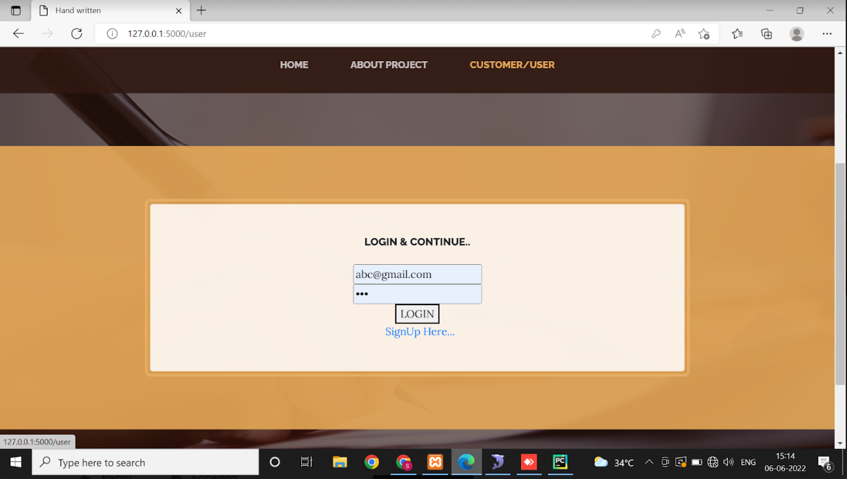
Contd..

Slide 29
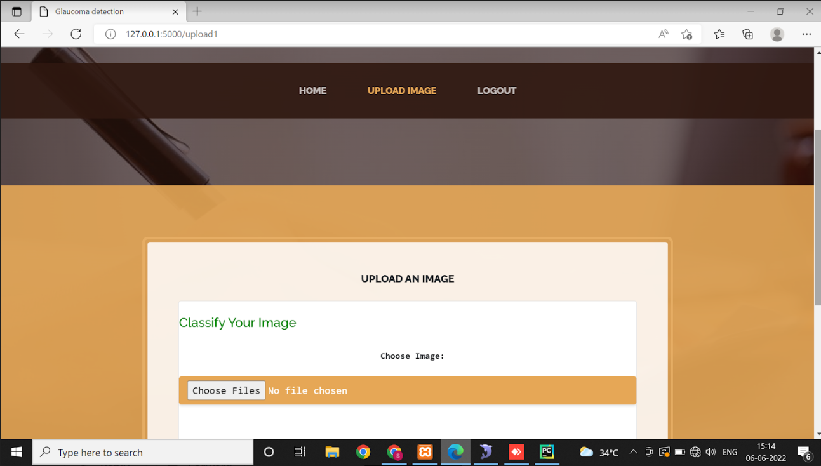
Contd..

Slide 30
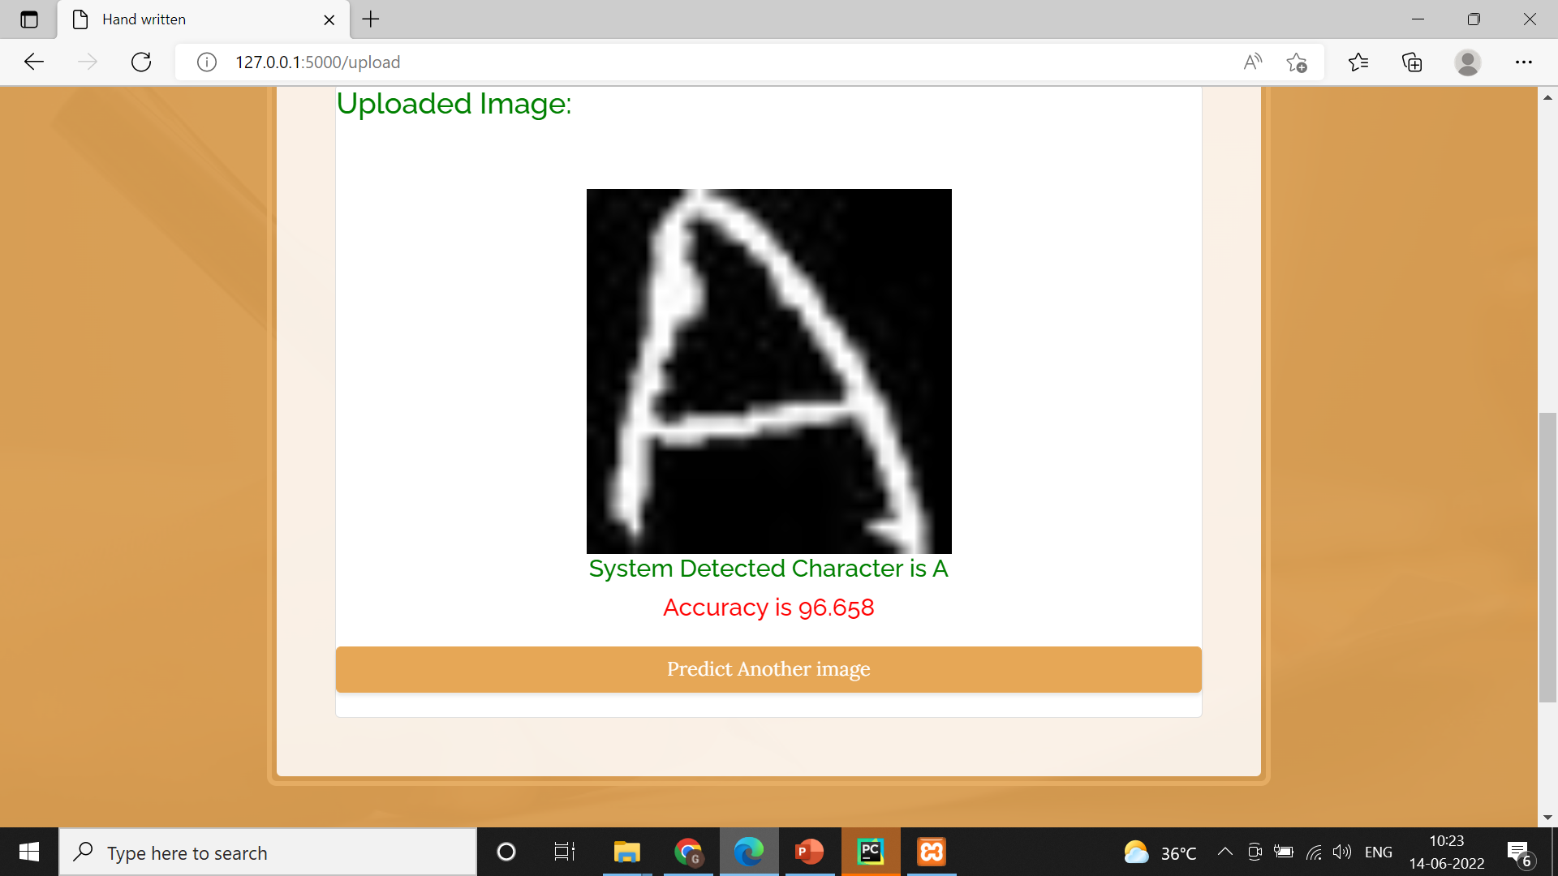
Contd..

Slide 31
Conclusion
In this project we have proposed a deep learning architecture with training character images and testing the images that classifies our test images.
The number of epochs were stopped at particular number because we have received a cut point after which the accuracy is not improving.

Slide 32
References
[1]. N.Prameela, P.Anusha and R.Karthik, “Off-line telugu handwritten characters recognition using optical character recognition”,” IEEE.org, 18 December 2017.Availablein:file:///C:/Users/admin/Desktop/dad/neft%20images%2022.12.2021/fil1.pdf. ..\Downloads\fil1.pdf
[2]. Prof. Vaibhav. V.Mainkar, Mr.Ajinkya B. Upade, Ms.Jyothi A.katkar and Ms.Poonam R.Pednekar, “Handwritten Character Recognition to obtain Editable Text” .
Available in: file: ICESC48915.2020.9155786 EDITABLE TEXT.pdf

Slide 33
Contd..
[3] Jomy john , Promod K.V , Kannan BalaKrishnan, “Offline Handwritten Malayalam Character Recognition “ ICETECT.2011.5760215 MALAYALAM.pdf
[4] Ahmed Subhi Abdalka “Survey for Databases On Arabic Off-line Handwritten Characters Recognition System” cais.2018.8442001 ARABIC.pdf
[5] Aiquan Yuan, Gang Bai, Lijing Jiao, Yajie Liu “Offline Handwritten English Character Recognition based on Convolutional Neural Network” das.2012.61 english.pdf

Slide 34
Thank You!!!

